Slide 1

PREDICTING CUSTOMER BUYING BEHAVIOUR
Aissiou Ikram 28/02/2023

Slide 2
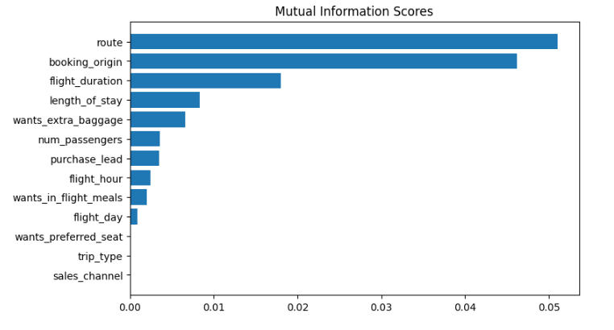
PREDICTIVE MODEL TO UNDERSTAND FACTORS THAT INFLUENCE BUYING BEHAVIOUR
We have trained the data set with Random forest classifier model using 6 features and all the features to see the difference and received
With 6 features only
ACCURACY: 83.36
AUC score: 0.565
With All the features
ACCURACY: 84.84
AUC score: 0.552
route
booking_origin
flight_duration
wants_extra_baggage
length_of_stay
are the top 5 features which influence Customer buying behavior We need to increase the AUC score.

